Slide 1
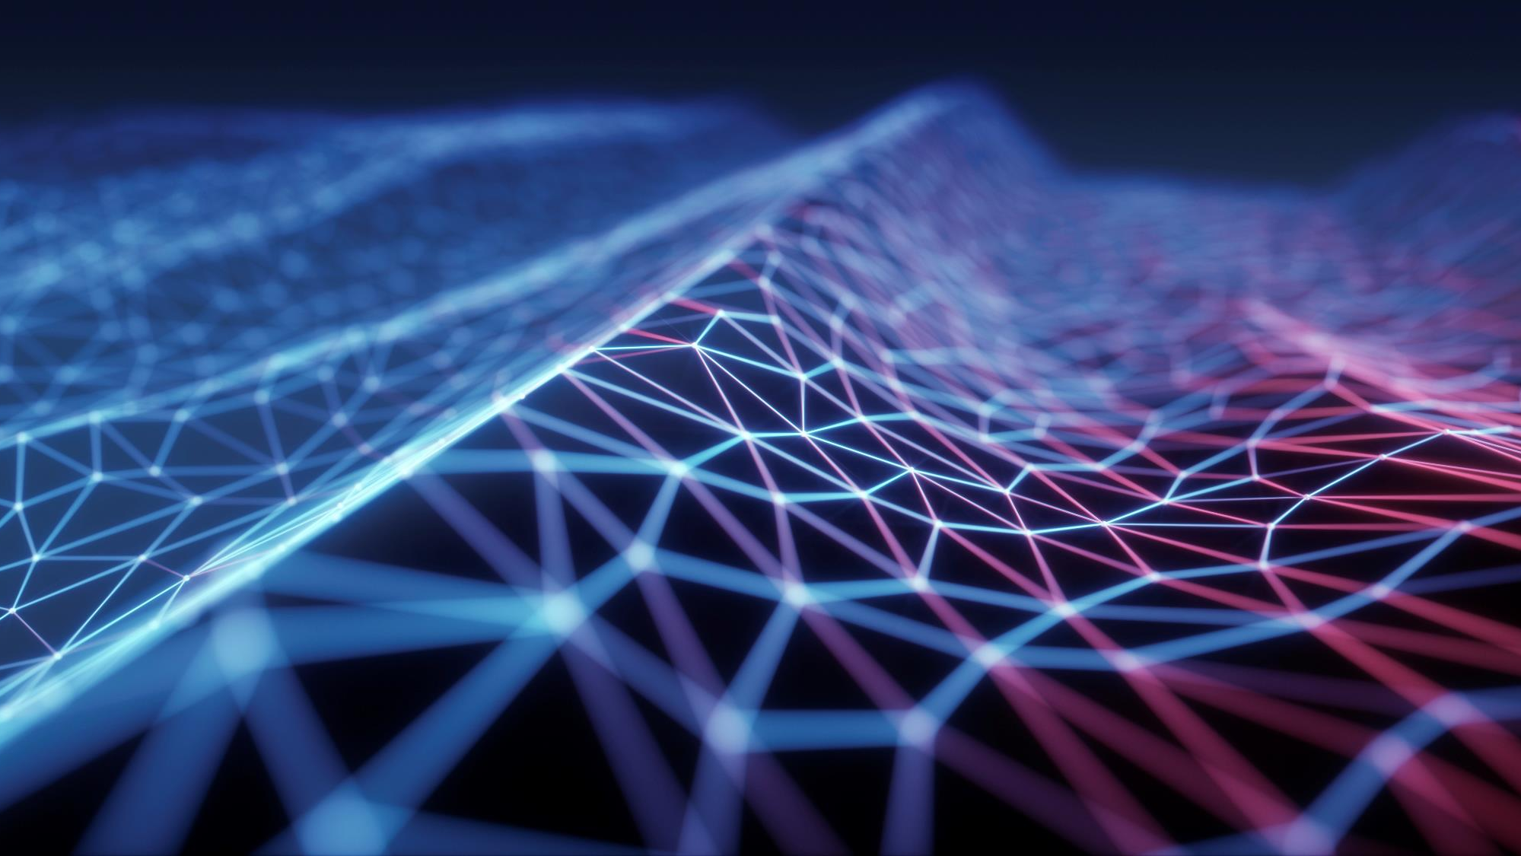
Image recognitions
Image recognition, also known as computer vision, is a challenging and exciting field in AI and machine learning. If you're working on a problem related to image recognition, here's a general outline of how to approach it:

Slide 2
Problem Definition Define the specific image recognition problem you're addressing. Is it object detection, facial recognition, or something else?

Slide 3
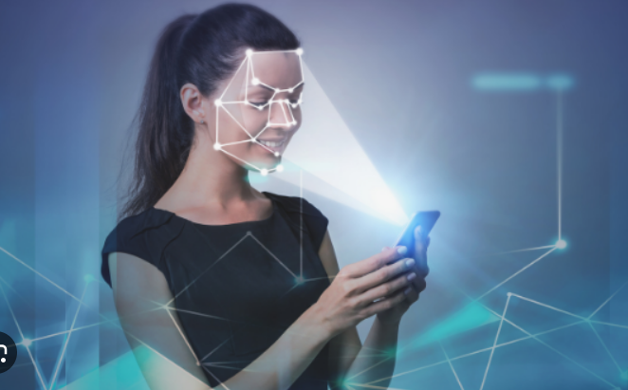
solution
Explain your approach to solving the image recognition problem.
If you're using machine learning or deep learning techniques, mention the algorithms or models you're using.
Highlight any unique features or methods you've incorporated into your solution.

Slide 4

Tech Stack
Image Acquisition
Feature Extraction
Data Preprocessing

Slide 5
How our Idea is Unique
Describe what makes your approach to image recognition unique or innovative.
Discuss any advantages or improvements over existing solutions.
Share any proprietary or novel algorithms or techniques you've developed.

Slide 6

:Architecture of Idea
Face Identity
Varification
Comparision and Identification
Feature Extraction
Feature Extraction
Face detection and cropping
Face detection and cropping
Test Image or Input Query

Slide 7

Thank You
Team phoenix

